Slide 1
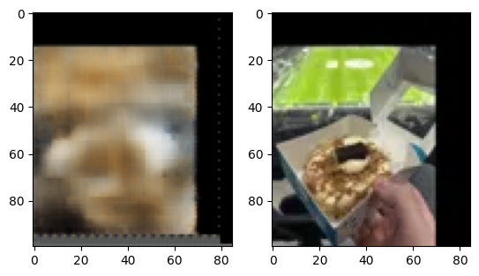
Green? What do you mean?

Slide 2
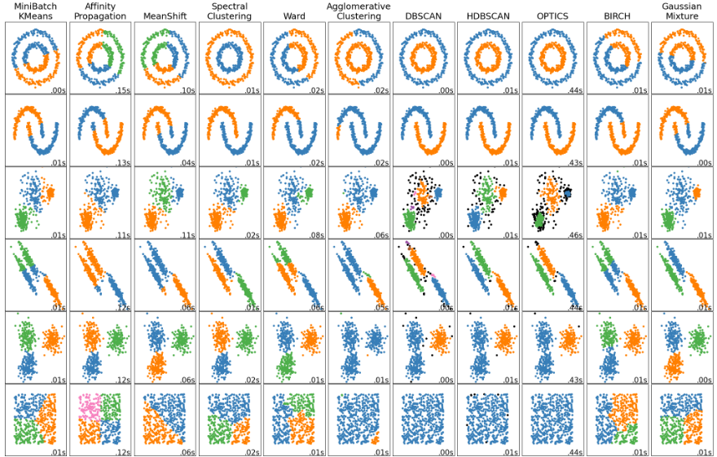
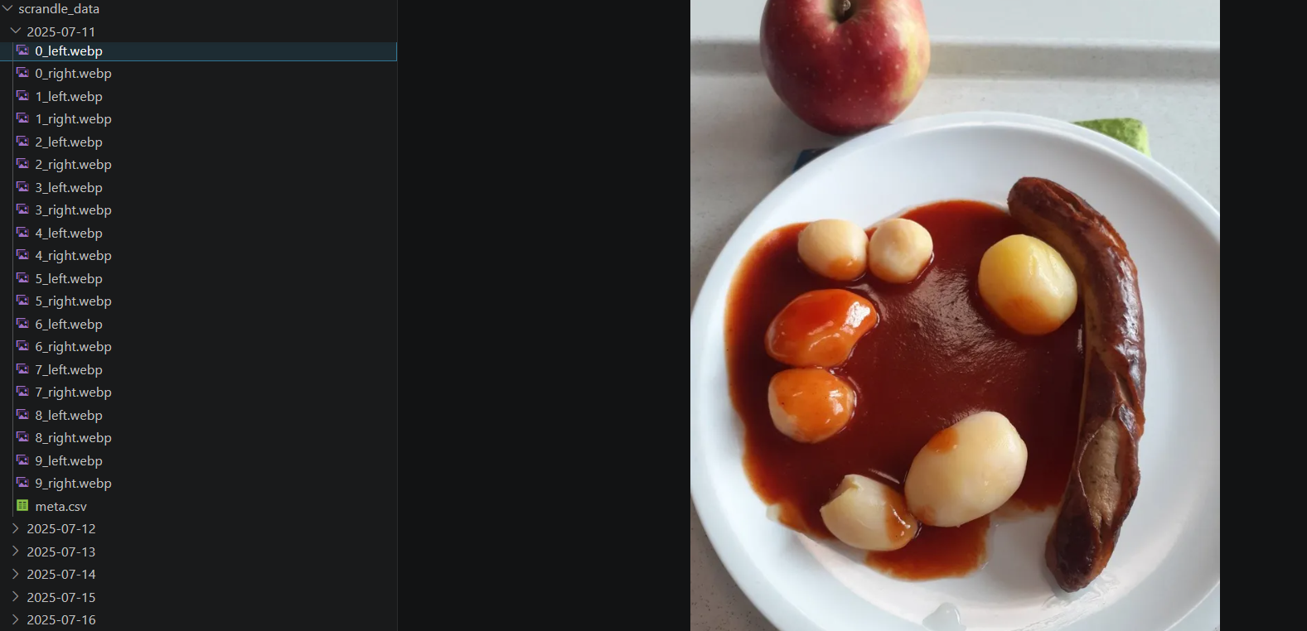
Outlier Removal – Two Methods
1. Manual Removal
2. Removal Via Clustering
Easy to implement
Slow
Manual
Sometimes hard to tell what is an outlier
Fast
Automatic
Requires variational autoencoder(VAE) or similar for images

Slide 3
VAE Model and Challenges
PLACE ILLUSTRATION OF MODEL ARCHITECTURE HERE
Recreation
Original
Normalisation
Image resolution
Conv2D vs. Conv2Dtranspose
GPU(NVIDIA GeForce RTX 4050)
“Green? What do you mean?”
Padding and output padding

Slide 4

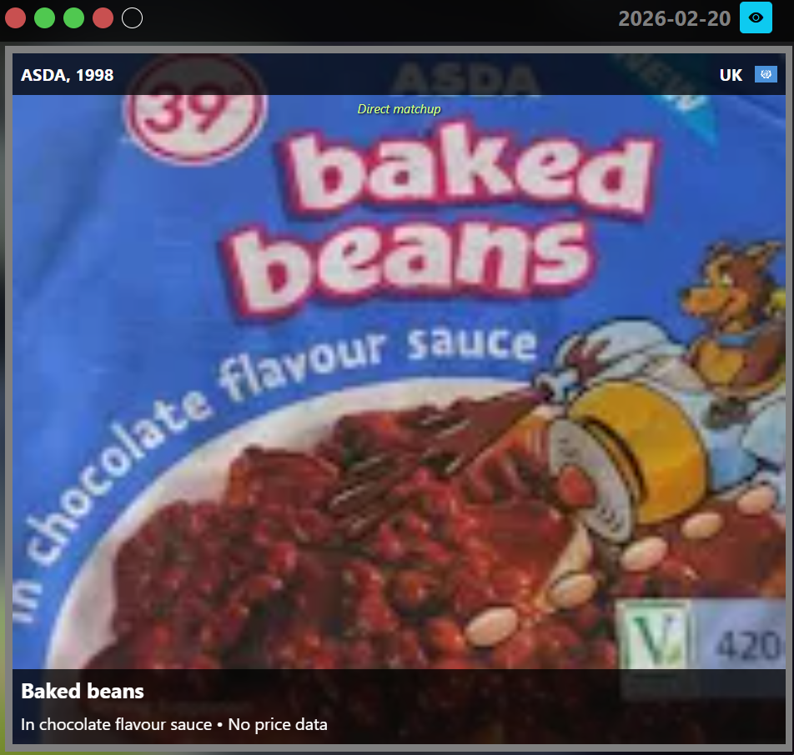
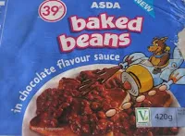
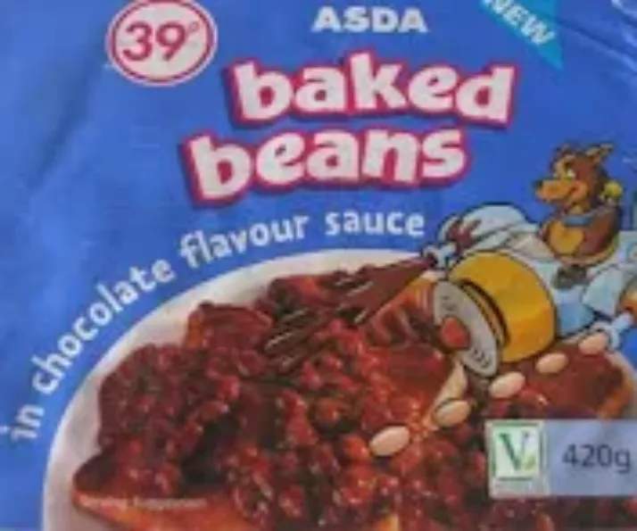
Processing the Images – The Worst Example
Padded to match largest possible image
Scrandle.com image
Scraped image
Centred and set to scrandle.com
aspect ratio

Slide 5
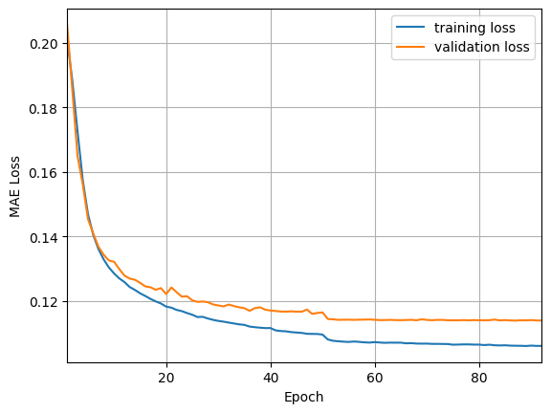
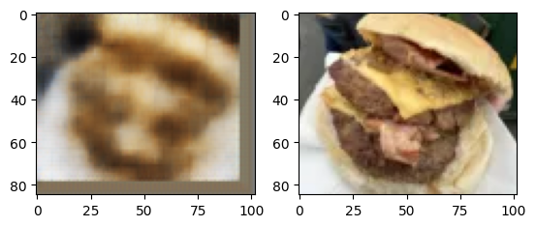
VAE Results
Using batch size of .. And 145 latent space dimensions.
Better results, despite higher loss
Still issues with green
Still borders
Solution: Use ResNet, redo decoder, HP optimization

Slide 6
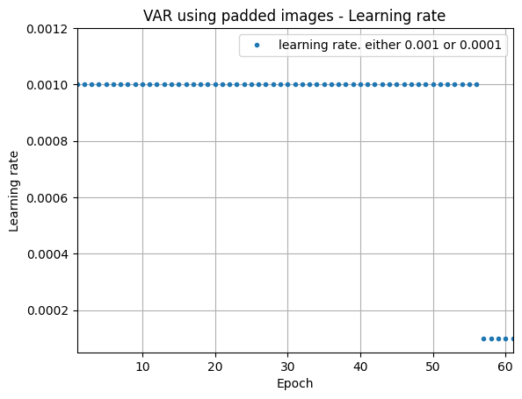
Appendix

Slide 7
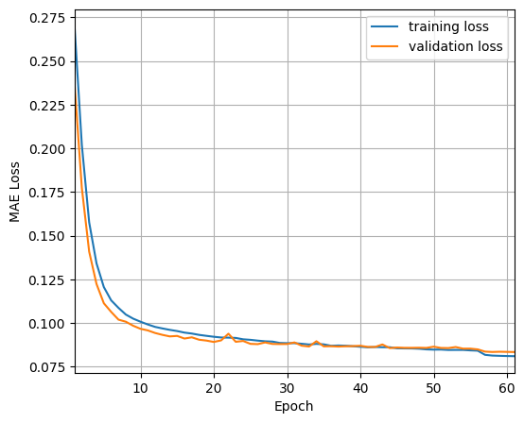
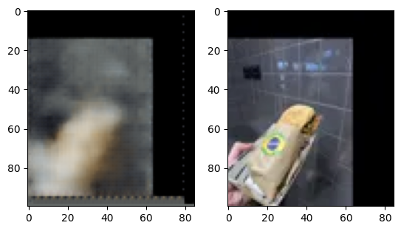
VAE results with padded images:

Slide 8
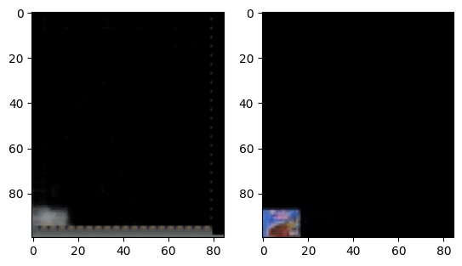

Slide 9
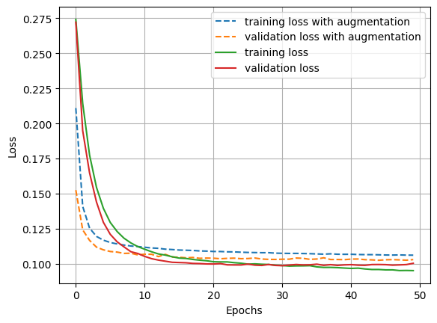

Slide 10
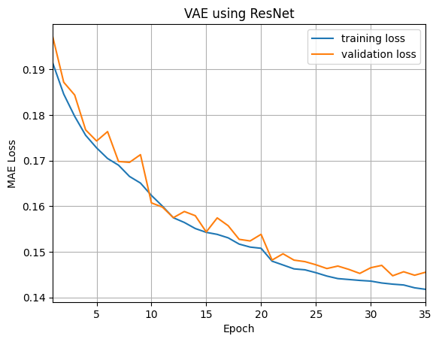
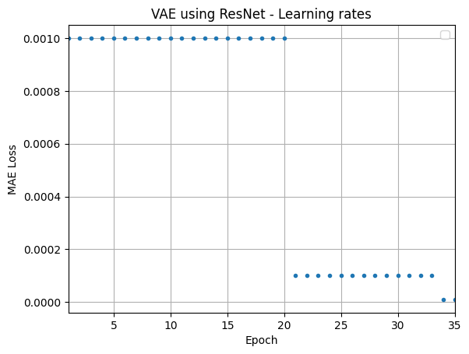

Slide 11
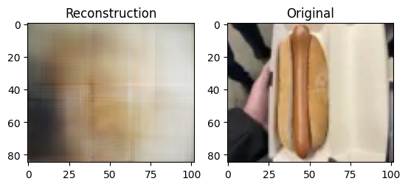
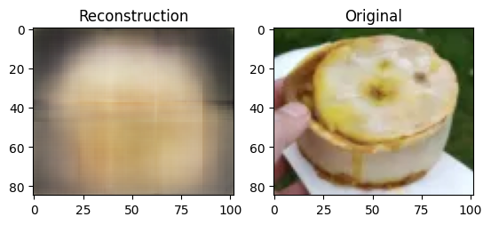
Resnet example image

